Slide 1
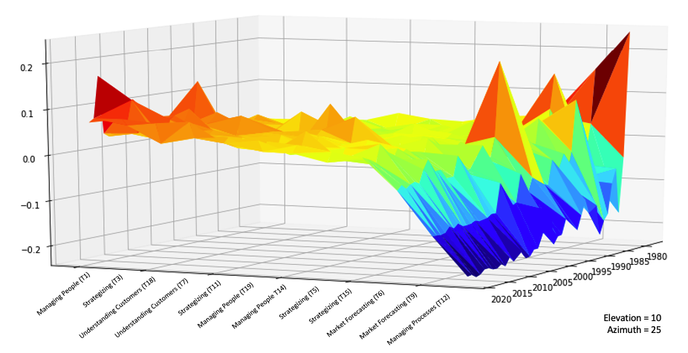
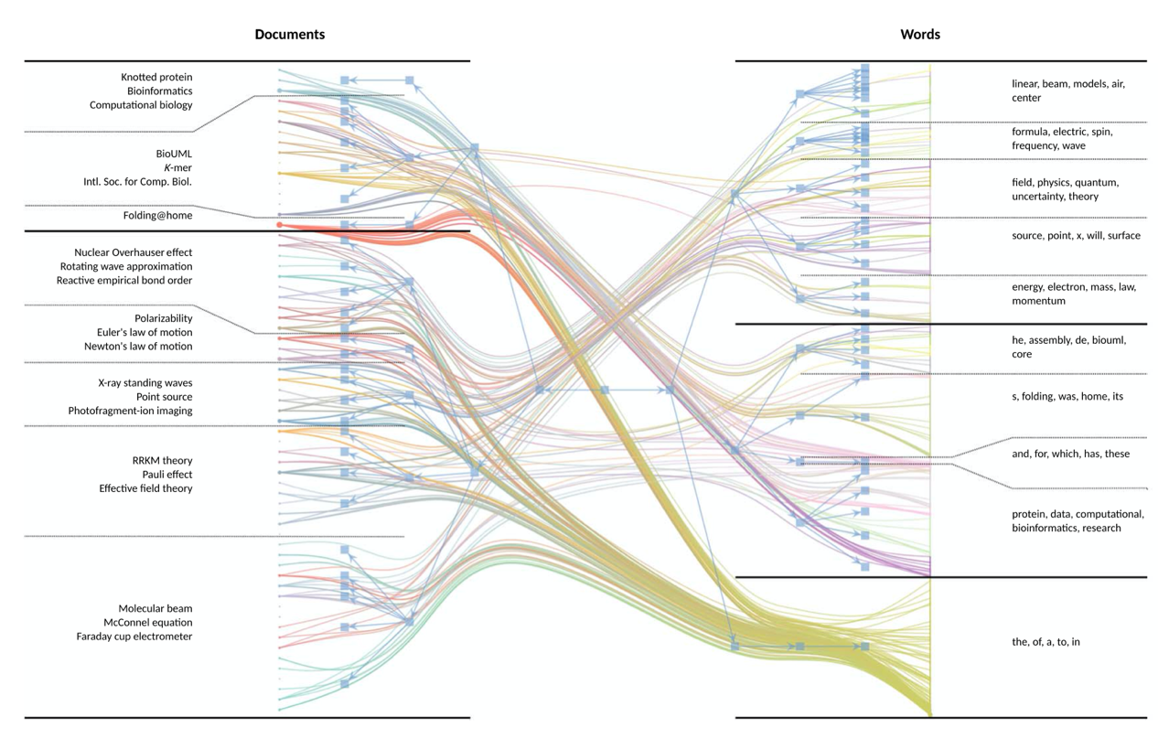
Topic Modeling Advances
Curating Corpora, Using Structured Models, and Theorizing with Visuals
Hannigan, Haans, Glaser, Tchalian, Valadao, Jennings
IDeaS
August 7, 2020

Slide 2
Check List for Co-Host Prior to Meeting
Make everyone co-hosts
Test chat functio n
Test breakout rooms(?)
Confirm with tech that we want move across breakout rooms
We don’t want to give the tech permission to leave
Find out what the AOM person should be doing (David Woods?)
Can we set the countdown for dissolution of breakout rooms?
Can we send global announcements across breakout rooms?
We need to lay out the protocol

Slide 3
If you like, along with this deck, you can check out the following resources in advance….
Links for resources for the session
Hannigan, T. R., Haans, R. F., Vakili, K., Tchalian, H., Glaser, V. L., Wang, M. S., ... & Jennings, P. D. (2019). Topic modeling in management research: Rendering new theory from textual data. Academy of Management Annals, 13(2), 586-632.
Schmiedel, T., Müller, O., & vom Brocke, J. (2019). Topic modeling as a strategy of inquiry in organizational research: A tutorial with an application example on organizational culture. Organizational Research Methods, 22(4), 941-968.
Other listed papers at the sites below.
IDeaS general page: http://www.interpretivedatascience.com/
GitHub: https://ideas-repo.github.io
If you examine this this deck in advance, we suggest that you refrain from looking at the exercise answers until after we do them collectively. ☺

Slide 4
Plan of the Session
Time (Mins) | Topic | Presenters
5-7 | Welcome, Rationale, Agenda, Protocols | Dev & Tim
5-7 | Rendering with a Focus on Visuals | Vern & Dev
15+5 | LDA & STM - Curation & Topic Modeling Methods for Visuals | Richard & Rodrigo Informational Questions Only Please
15+15 | STM Exercise in Breakout Rooms (6) – Interactive (How to read output – 2 components) | Set Up- Random Assignment + General Discussion
15+5 | hSBM & Hierarchical Models - Curation & Topic Modeling Methods for Visuals | Tim & Hovig Informational Questions Only Please
15 + 15 | hSBM Exercise in Breakout Rooms (6) – Interactive (What to do with the outputs – 3 components) | Set Up- Random Assignment + + General Discussion
10 | Back to Rendering Visuals, & Visualization Theory | Tim & Vern
5 | Next IDeaS Workshop, Resources | Dev (but all please chime in ☺)

Slide 5
Protocol
Random assignment to breakout rooms of 5 etc.
Sorry but no mid-point refresh, so please take the time when you have a moment (for standing, etc.).

Slide 6
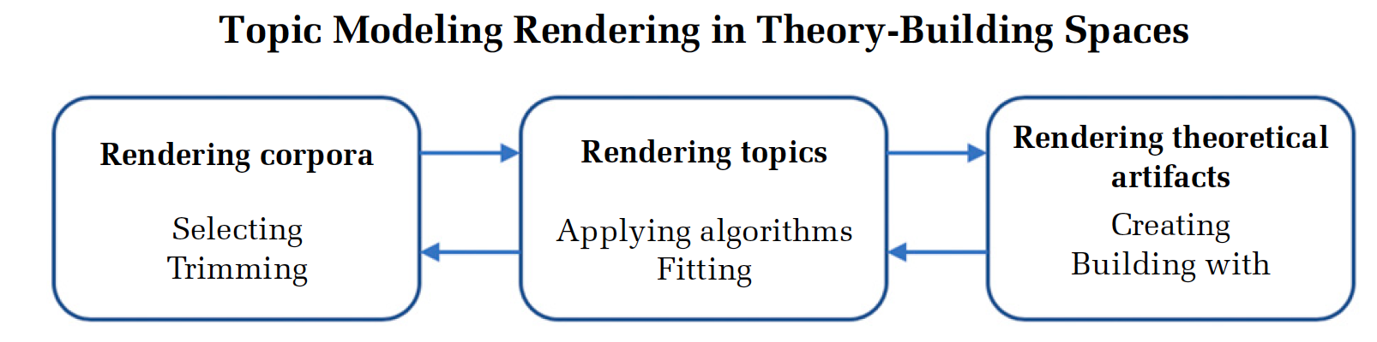
How can we use topic modeling to generate new theoretical insights?

Slide 7
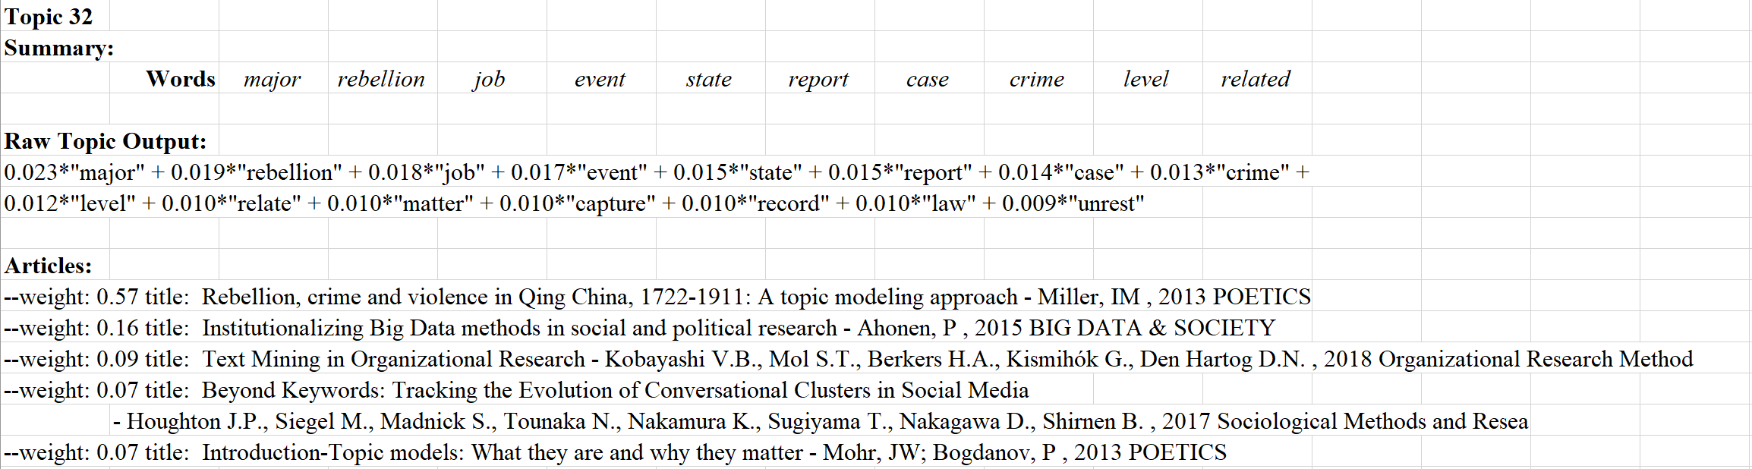
Visualization: A key step in the rendering process

Slide 8
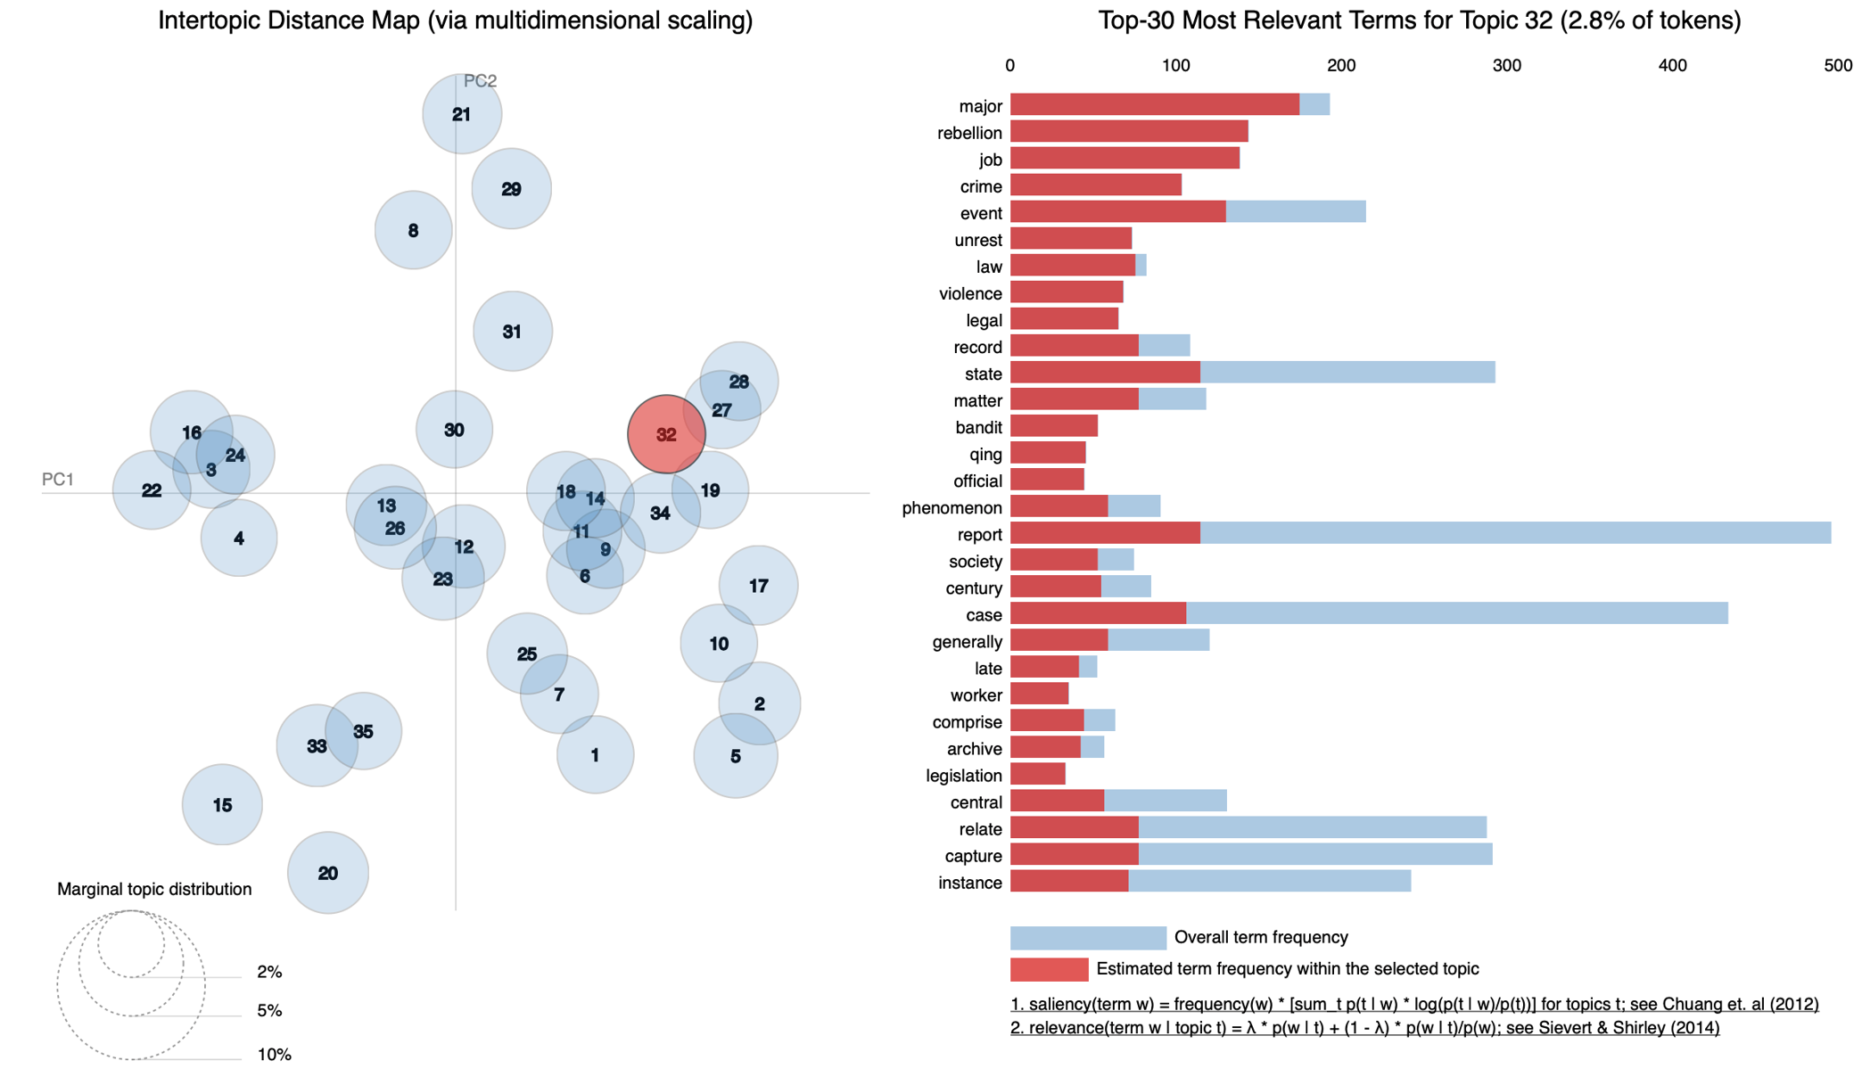
Visualization: A key step in the rendering process

Slide 9
The Importance of Visuals
Theories of institutions, culture, relationality and neo-structuralism have all underscored the importance of visuals:
As artifacts (especially symbols) in cultures
As boundary objects in field relations
As representations of deeper structure
As rhetorical devices
As improved measures of extant concepts.
Notes:
Vern is doing this.

Slide 10
Two illustrations of visualization in advanced topic modeling techniques
Structural topic modeling (STM)
(Richard Haans and Rodrigo Valadao)
Hierarchical stochastic block modeling (hSBM)
(Tim Hannigan and Hovig Tchalian)
Notes:
Arc of community, LDA has virtues; we need to move further and open the black box; acknowledge other methods… NLP, etc. do work with the rendering ;process.

Slide 11
Moving Beyond LDA & Standard Topic Modeling – STM
Example / Exercise Part I
(Richard Haans & Rodrigo Valadao)
Hannigan, Haans, Glaser, Tchalian, Valadao, Jennings
IDeaS
August 7, 2020

Slide 12
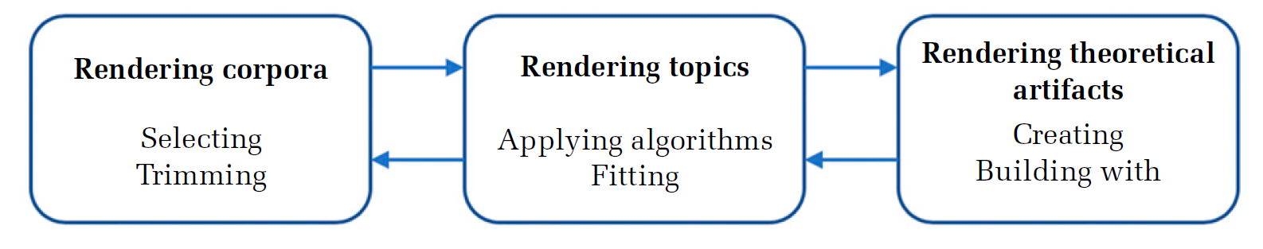
STM and rendering
Metadata can more directly inform sample selection; cleaning of metadata more important ex ante.
Novel algorithms, model fit as determined not just by fit statistics but also now considering degrees of freedom (variables / topics ratios).
Novel theoretical artifacts such as covariate-topic effect estimates.
Richard Haans, Erasmus University Rotterdam, August 7th 2020

Slide 13
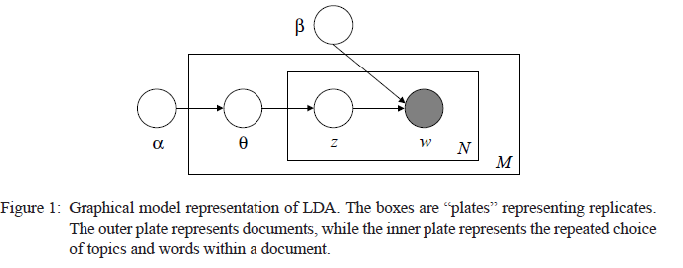
Basic LDA
(darker circle is what is observed; white circles what is learned)
The topic model learns only from the observed words co-occurrences in documents.
Assumption: identical generative processes behind texts in a corpora: documents are created based on drawing from a fixed set of topics—unchanging over time, independent of who generated the topics, etc.
Richard Haans, Erasmus University Rotterdam, August 7th 2020

Slide 14
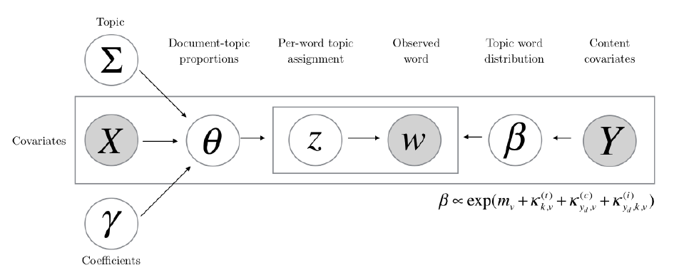
Structural TM
A recent innovation is the ability to incorporate information from metadata into the estimation of the topic-word distribution or the document-topic proportions. Most common is the latter.
This enables understanding how e.g. characteristics of the document producer or contextual factors shape the extent to which topics are used in documents.
Richard Haans, Erasmus University Rotterdam, August 7th 2020

Slide 15
Canonical references
Roberts, M. E., Stewart, B. M., Tingley, D., Lucas, C., Leder‐Luis, J., Gadarian, S. K., Albertson, B., & Rand, D. G. (2014). Structural Topic Models for Open-Ended Survey Responses. American Journal of Political Science, 58(4), 1064–1082. https://doi.org/10.1111/ajps.12103
Roberts, M. E., Stewart, B. M., & Airoldi, E. M. (2016). A Model of Text for Experimentation in the Social Sciences. Journal of the American Statistical Association, 111(515), 988–1003. https://doi.org/10.1080/01621459.2016.1141684
Schmiedel, T., Müller, O., & vom Brocke, J. (2018). Topic Modeling as a Strategy of Inquiry in Organizational Research: A Tutorial With an Application Example on Organizational Culture. Organizational Research Methods, 109442811877385. https://doi.org/10.1177/1094428118773858
See: https://www.structuraltopicmodel.com/ for info on the method and applications.
In particular: the ‘STM’ package in R opens many uses.
Richard Haans, Erasmus University Rotterdam, August 7th 2020

Slide 16
‘STM’ package
The STM package in R is attractive because essentially works from the basic topic modeling approach using packages like ‘topicmodels’.
See e.g. the materials from https://ideas-repo.github.io/workshops/
The metadata that was used ex post in those sessions can now be incorporated directly into the topic model.
Richard Haans, Erasmus University Rotterdam, August 7th 2020

Slide 17
Usual workflow (the practice)
Read the corpus; clean as usual using packages like ‘tm’ (see 2017 session).
Turn corpus into document-term matrix.
Read the metadata; make sure sequence of documents is identical to the sequence in the corpus / dtm (sorting can be different).
Use the readCorpus function with “type = c("slam")”to convert the dtm to the STM format. Add the metadata (again; sorting has to be identical).
Use functions like searchK to identify best-fitting number of topics; stm to estimate the selected model; labelTopics to render topics; and estimateEffect and plot to interpret effects of covariates.
Richard Haans, Erasmus University Rotterdam, August 7th 2020

Slide 18
A Research Application & Exercise
EARLY MOMENTS OF INSTITUTIONAL CHANGE
POSSIBILITIES
CATEGORY SCHEMAS
MEANING INFRASTRUCTURE
Enable and constrain possibilities for institutional change.
(Hannigan & Casasnovas, 2020; Obstfeld et al., 2020; Thompson et al., 2018; Lounsbury and Glynn, 2019)
Discursively constituted.
Precursor to action.
Interstices of identity positions → shaped by category schemas.
(Lounsbury and Glynn, 2019)
Analytically, by the time product categories coalesce in a market or industry, we have already lost sight of the early moments of institutional change.
Product categories → cognitive infrastructure of markets (Lounsbury and Rao, 2004).
Meaning infrastructure → building blocks of an underlying institutional meaning system.
How to capture the meaning infrastructure that shapes the space of possibilities at the early moments of institutional change?
Rodrigo Valadao, University of Alberta, August 7th 2020

Slide 19
Methods
EMPIRICAL SETTING
The Emerging Field of Data Science: a case of an emergent (Maguire et al., 2004), interstitial issue field (Zietsma et al., 2017)
Abductive approach: 30 semi-structured interviews and 185 archival interviews with well-positioned actors (e.g., chief-data scientists, VPs of data science), conducted between 2017 and 2019.
Computational Approach: Search on EBSCOhost Web for publications by Harvard Business Review articles that contained the keywords “data” or “analy*” and issued between 1978 and 2018 (N = 3,005).
DATA COLLECTION
Abductive approach: close examination of the interviews to develop a rich understanding of the empirical context (Kaplan, 2015; see Hirsch & Lounsbury, 1997 and Lounsbury, 1998, 2001 for a similar methodological approach).
Computational approach: Structural Topic Modeling (STM) of the HBR articles following a three-stages rendering process (see Hannigan et al., 2019).
DATA ANALYSIS
Rodrigo Valadao, University of Alberta, August 7th 2020

Slide 20
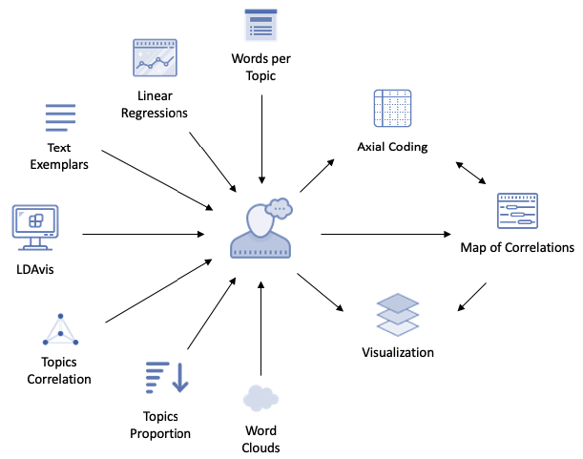
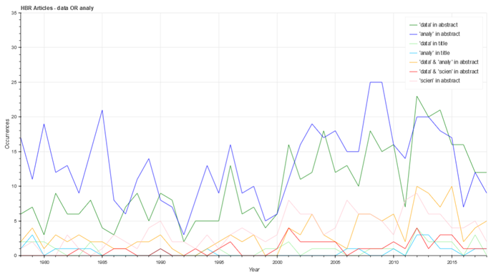
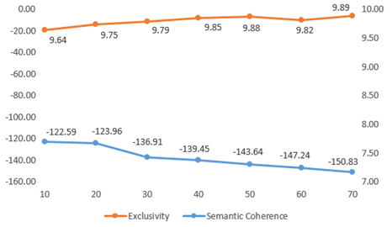

Rendering with STM (my demo)
RENDERING THEORETICAL ARTIFACTS
RENDERING A CORPUS
RENDERING TOPICS
*
1
*
*
2
*
3
”Data” & “Analy*” in the abstract
* Not part of the stm package in R.
These 3 artifacts and additional instructions are going to be provided for discussion in the Break-Out session
Rodrigo Valadao, University of Alberta, August 7th 2020

Slide 21
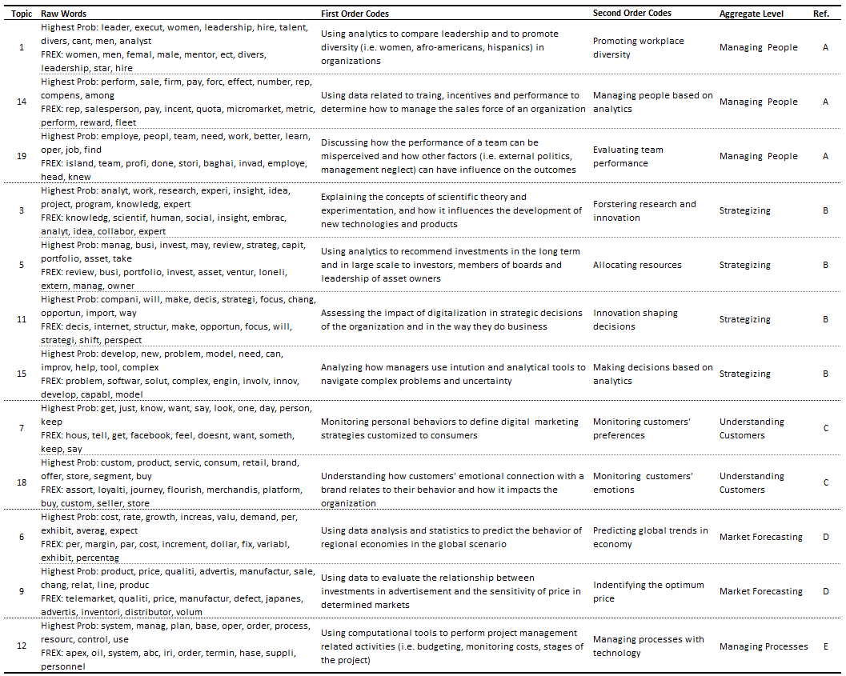
Axial Coding
Topics interpreted as elementary categories of meaning that constitute the meaning infrastructure of the emerging field of data science.
STM x “Standard” Topic Modeling
1
Topics (i.e., clusters of words from STM)
Axial Coding
Rodrigo Valadao, University of Alberta, August 7th 2020

Slide 22
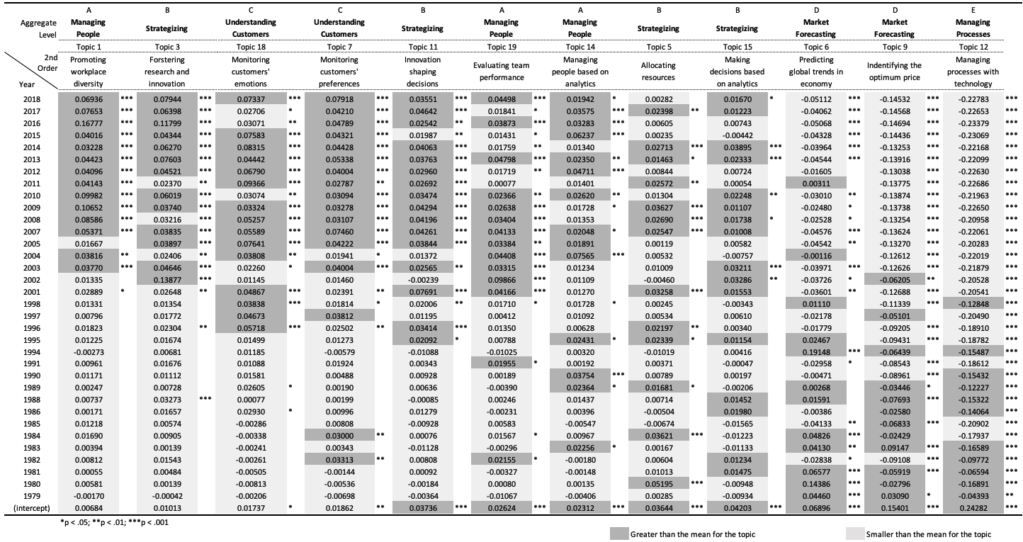
Map of Correlations
Topics (from previous slide)
2
Year of publication
Rodrigo Valadao, University of Alberta, August 7th 2020

Slide 23
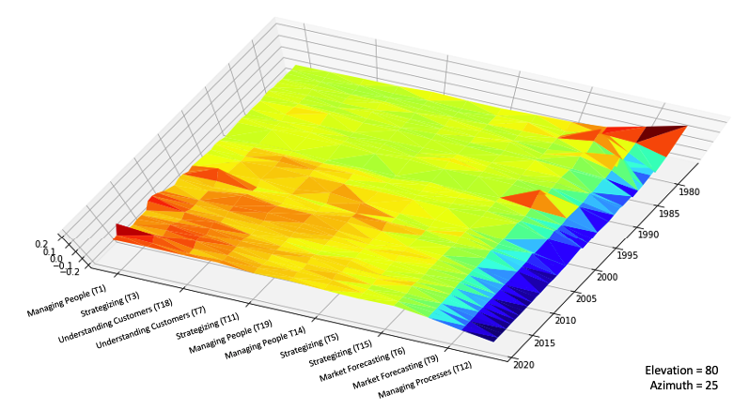
Visualization
3
Rodrigo Valadao, University of Alberta, August 7th 2020

Slide 24





Break-Out Session 1
Instructions
A. Each group will receive a handout with instructions and a copy of the three theoretical artifacts presented here.
B. Key Task: Discuss with your colleagues some potential interpretations of the theoretical artifacts and unfolding theorizations related to the research question: How to capture the meaning infrastructure that shapes the space of possibilities at the early moments of institutional change?
C. Pay special attention to patterns that might be identifiable into the artifacts , and take into consideration the following additional information:
D. After the break-out session, we will briefly present a potential theorization and hear back from the groups.
1
Axial Coding
2
Map of Correlations
Visualization
3
In the interviews, most informants described 2010 as the year of emergence of Data Science as a field
Rodrigo Valadao, University of Alberta, August 7th 2020

Slide 25
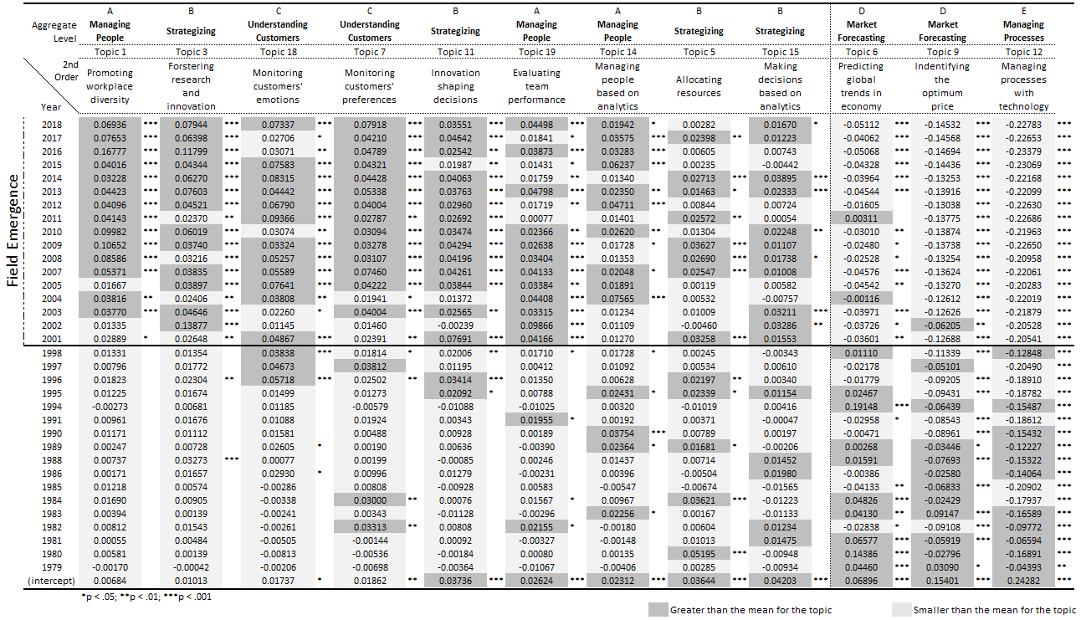
Discussion
Positive and negative associations of elementary category schemas of meaning over time.
2000 x 2010: Divergence in the year detected by different approaches as the beginning of the emergence of the field (computational vs interviews).
+
-
Rodrigo Valadao, University of Alberta, August 7th 2020

Slide 26
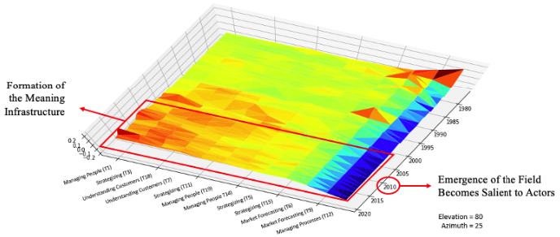
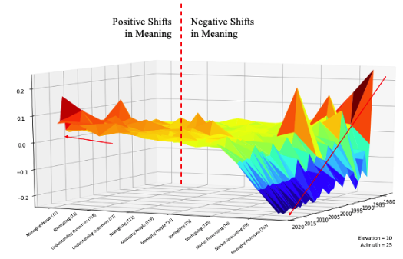
Discussion
Early Moments of Institutional Change
A meaning infrastructure is formed through the amalgamation of novel category schemas of meaning in combination with the exclusion of others
1
Distinct periods during the early moments of institutional change:
First period (i.e., 2000-2010) → tacit and not evident.
Second Stage (i.e., 2010-ongoing): might assign a more agentic phase, in which new practices start to become more closely connected to the meaning infrastructure.
2
Rodrigo Valadao, University of Alberta, August 7th 2020

Slide 27
The Big Picture about STM
Meaning is a key component to understand change but has been difficult to operationalize it empirically (Mohr et al., 2020).
STM enables to develop new types of visualizations and opens an array of possibilities for novel theorizations.
Future Directions:
Studies can increase the variety of metadata used as covariates in the STM technique. Authorship, for example, shall enable to populate studies of meaning with a more agentic and multidimensional perspective .
Future studies might want to take into account the pace of change. The angular coefficient of the correlations produced by the STM technique might afford this sort of analysis, which requires further development of the technique.
Rodrigo Valadao, University of Alberta, August 7th 2020

Slide 28
Moving Beyond LDA & Standard Topic Modeling – hSBM
Example / Exercise Part 2
(Hovig Tchalian & Tim Hannigan)
Hannigan, Haans, Glaser, Tchalian, Valadao, Jennings
IDeaS
August 7, 2020

Slide 29
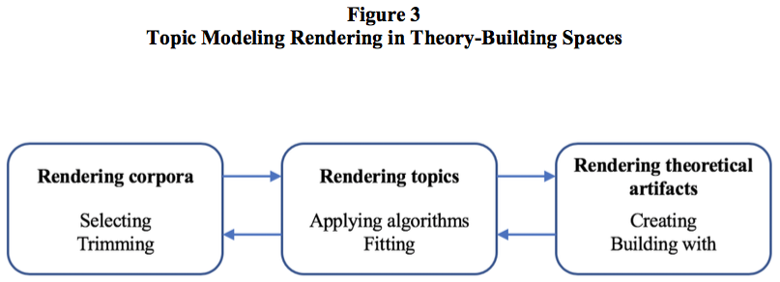

Building Up Visuals for Theorization Case Application & Exercise
Can also identify temporal breaks
Must be rigorous + interpretable
Visuals help build theory
Hannigan et al. (2019). Topic modeling in management research: Rendering new theory from textual data. Academy of Management Annals, 13(2), 586-632,

Slide 30
hLDA As Visual Artifact: Malaysia Flight 370
Smith, Hawes & Myers, Hie ́rarchie: Interactive Visualization for Hierarchical Topic Models (2014, Proceedings of the Workshop on Interactive Language Learning, Visualization, and Interfaces, p. 73)

Slide 31
Two Alternative (and Distinct) Hierarchical Models
hLDA
hSBM
Supervised / top-down model
Researcher chooses # of levels
(but not # of topics)
Topics can be difficult to label / interpret
Visualizations can be crude
(excel + sunburst diagram)
Blei, Griffiths & Jordan, The nested Chinese restaurant process and Bayesian nonparametric inference of topic hierarchies (Journal of the ACM, Vol. 57, No. 2, Article 7 2010)
Unsupervised, network-based model
Model chooses number of topics and number of levels (optimizes both parameters)
Topics more interpretable + traceable (docs < > terms)
Visualization more dynamic (esp. with code-level access)
Overcomes limitations of LDA models with natural language; ie, burstiness, correlations between topics
Notes:
Supervised LDA models documents and contextual information (in the form of a response variable, e.g., film ratings) together, in order to see what model best predicts the response variable.
Two approaches not just two supervised alternatives, two fundamentally different choices / choice points.

Slide 32
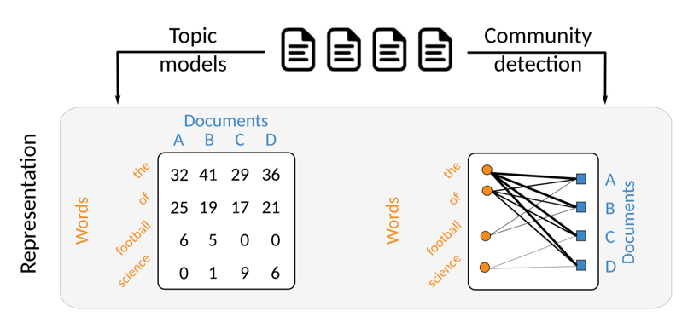
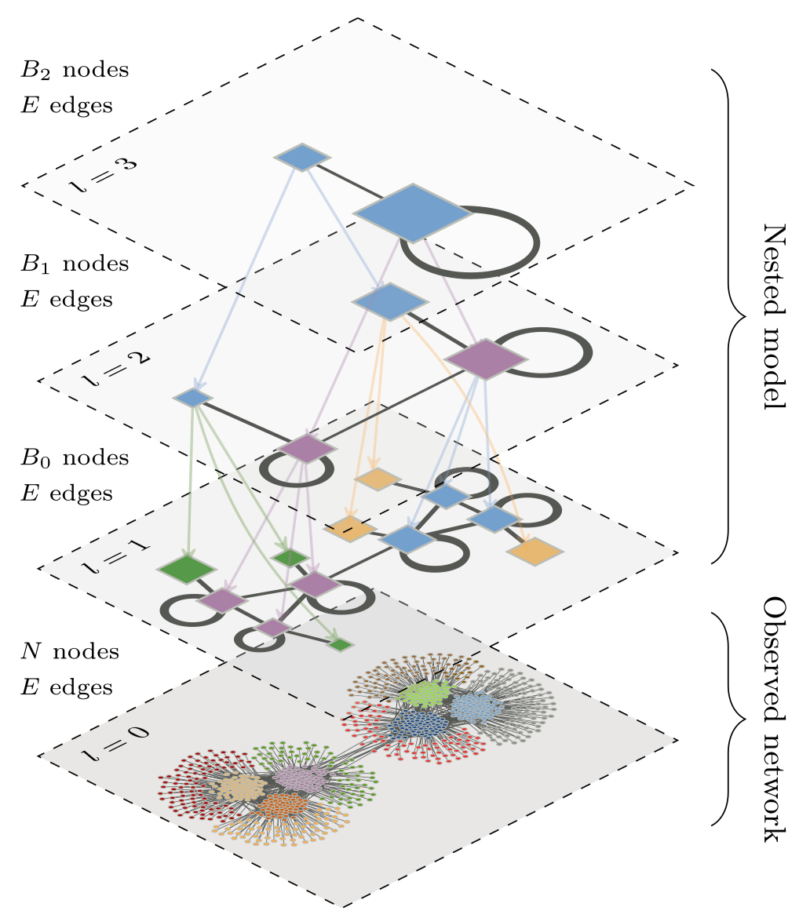
HSBM Offers Powerful Visualization + Theorization
A network approach to topic models -> hierarchical stochastic block modeling (hSBM)
Canonical papers:
Gerlach, M., Peixoto, T. P., & Altmann, E. G. (2018). A network approach to topic models. Science Advances, 4(7), eaaq1360.
Peixoto, T. P. (2014). Hierarchical Block Structures and High-Resolution Model Selection in Large Networks. Physical Review X, 4(1), 011047.
hSBM software (code): https://github.com/martingerlach/hSBM_Topicmodel/blob/master/TopSBM-tutorial.ipynb

Slide 33
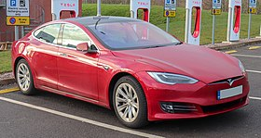
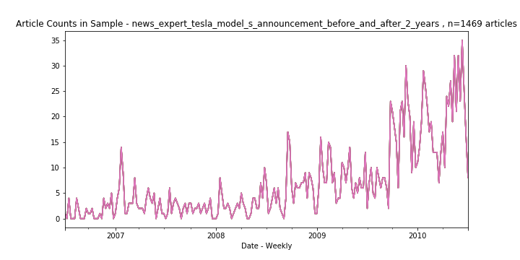
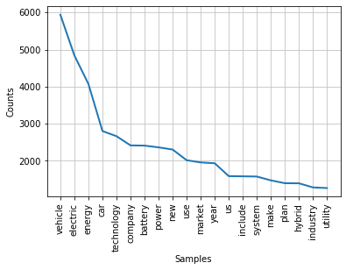
Case: Emergence of the Electric Vehicle Market
Exploratory Research Question: Is there an inflection point in the EV market emergence where the discourse changes?
Following the Rosa et al. (1999) study on the minivan market, we track discourse from expert publications in the Electric Vehicle market
First exploration: whether the announcement of the Tesla Model S (June 30, 2008) corresponded with a discourse change
Simple frequency analysis of article counts is promising, showing increase over time; but content analysis is inconclusive

Slide 34

Case: Emergence of the Electric Vehicle Market
We used two years of textual data (articles from expert publications) before and after the Model S announcement (2006-06-30 -> 2010-06-30)
The figure on the right shows the hSBM visual output
There are 4 levels of topics in this hierarchy
We manually read the topics at the top level of abstraction, then went down to level 3 which were meaningful
We then tracked topic salience over time (next slide)
Documents
Level 4
Level 3
Level 2
Level 1
Words

Slide 35



Break-Out Session 2
Excel includes three artifacts:
hSBM visualization
hSBM topics outputs
Top 2 levels: 4 + 3
Topic-specific terms
Ranked by weight (high >> low)
Sheets for your additions
Follow Excel instructions:
Use hSBM visual to inspect topics
Label L4 topics + L3 sub-topics, iterating back to L4
Identify preliminary theoretical insights

Slide 36
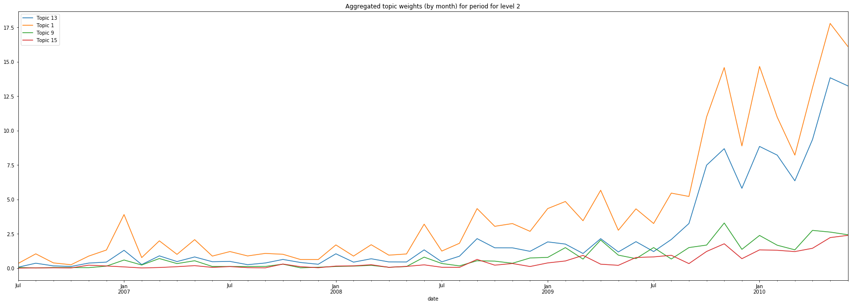
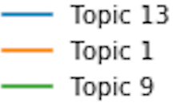

Discussion: Emergence of the EV Market
Topic 13 – Customer Design
Topic 1 – EV technology & Consumer Development
Topic 9 – Utilities, Smart Grid
Topic 15 – Nissan Leaf
June 30, 2008
Tesla Model S announced
March 26, 2009
Tesla Model S Prototype
displayed at Press Conference
Because overall article counts increased in the latter part of the period, we would expect to see some overall increase in topic salience over time
From this figure, we see that Customer Design, EV Technology and Consumer Development topics increased after the Model S announcement
Topics around Utilities, Smart Grid and the Nissan Leaf (EV) increased far slower

Slide 37



Theorization Is a Dynamic, Iterative Process
Hannigan et al. (2019). Topic modeling in management research: Rendering new theory from textual data. Academy of Management Annals, 13(2), 586-632,

Slide 38
More Specifically, Rendering with STM & hSBM Enhances Visuals.
Theories of institutions, culture, relationality and neo-structuralism have all underscored the importance of visuals:
As artifacts (especially symbols) in cultures (likely in terms of capturing centrality of key cultural artifacts)
As boundary objects in field relations (likely, because discourse strands more evident)
As representations of deeper structure (in combo with LDAviz, become more powerful)
As rhetorical devices (very likely, once storylines are worked out more… remains to be seen)
As improved measures of extant concepts (already true, based on examples)

Slide 39
Topic Modeling Is An Interpretive Data Science (IDS)
LDA and other implementations of topic modeling identify latent structure, based on a (dirichlet) probability distribution
But generating insights requires a healthy dose of interpretation
IDS combines quantitative and qualitative insights
Methods more advanced than LDA allow for a more dynamic, iterative process of theorization
Visualization can act as a critical aid to the theorization process

Slide 40
What’s Next?
IDeaS Workshop late 2020 or early 2021 = our “big tent” community
New, and update: IDeaS general page: http://www.interpretivedatascience.com/
Updated GitHub: https://ideas-repo.github.io
Special Issue, we hope. ☺
We hope that you folks don’t mind being signed up to our community. If you don’t want any info on the IDeaS event, please let me know.

Slide 41
Topic Modeling Advances
Thank You!
Hannigan, Haans, Glaser, Tchalian, Valadao, Jennings
IDeaS
August 7, 2020

